Slide 1

Cultural Festival Experience Games
Team 4 midterm presentation
presenter 20144824 Hong dae hwa
20144720 Choi ju ho
Chosun University
Notes:
…

Slide 2
CONTENTS
01 02 03 04 05
game introduce
Progress status
Add-on
Roles and schedules
Q&A
game introduce
Progress status
Add-on
Roles and schedules
조선대학교
Notes:
http://minheeblog.tistory.com/category/PPT

Slide 3
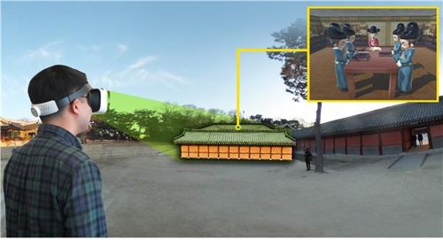
game introduce
Cultural Festival Experience Games
01
Cultural Festival Experience Games
Introduce cultural assets through VR game
A game to introduce cultural assets that we didn't know much about while having a quiz and a cultural experience about history,
and to make it easier to see and promote cultural assets by using the characteristics of games.
Notes:
http://minheeblog.tistory.com/category/PPT

Slide 4
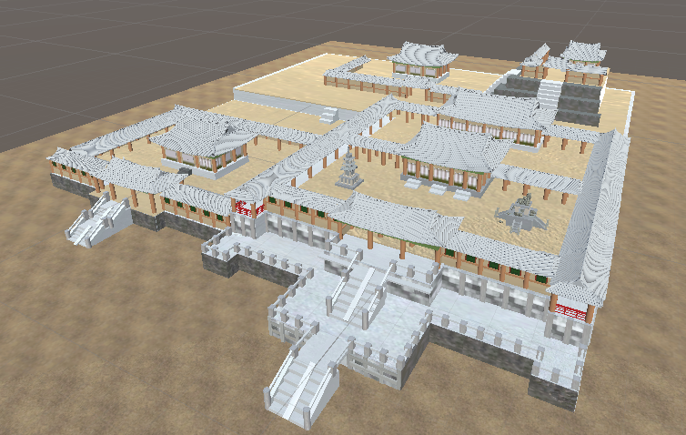
Progress status
Cultural Festival Experience Games
02
Stage1 : bulguksa
The temple is based on the origin of the Silla Dynasty and was designated as a UNESCO World Heritage Site in 1995 in with Seokguram, the middle of Mt. Toham.
major cultural assets
Dabotap (National Treasure No. 20), Seokgatap (National Treasure No. 21) etc.
Notes:
http://minheeblog.tistory.com/category/PPT

Slide 5
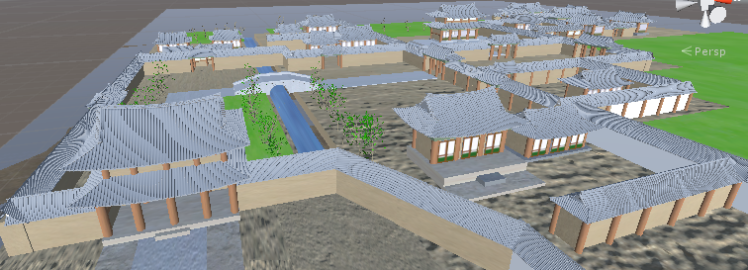
Progress status
Cultural Festival Experience Games
02
Stage 2 : Changdeokgung
In 1404, Taejong, the third king of Joseon Dynasty, built the palace for Jecheon-do of Hanyang.
Kings of this era often traveled to palaces, most of which used Changdeokgung Palace, the only palace that existed throughout the Joseon Dynasty from the beginning of the Joseon Dynasty to the end of the Joseon Dynasty.
It was also registered as a UNESCO World Heritage among the five major palaces of Joseon in 1997
major cultural assets
inJeongjeon (National Treasure No. 225)
Donhwamun (Treasure No. 383)
Notes:
http://minheeblog.tistory.com/category/PPT

Slide 6
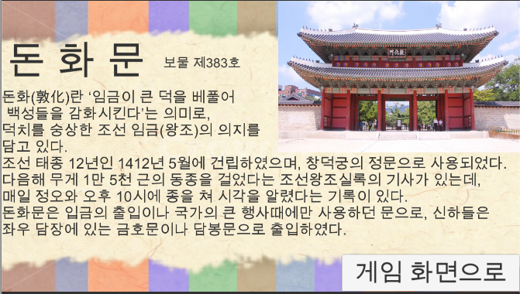
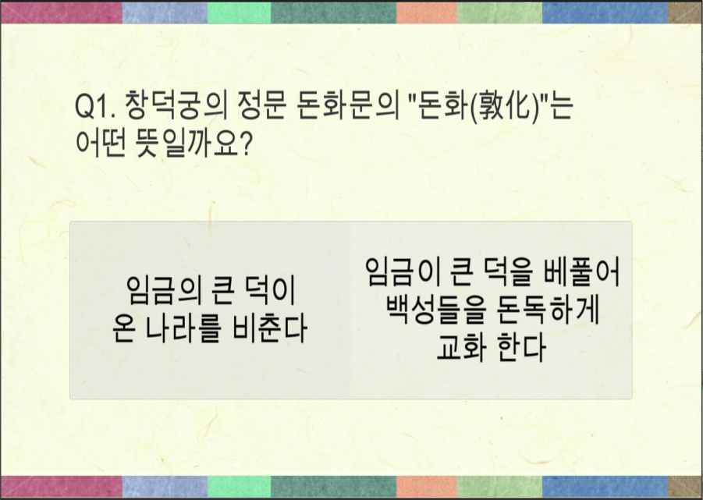
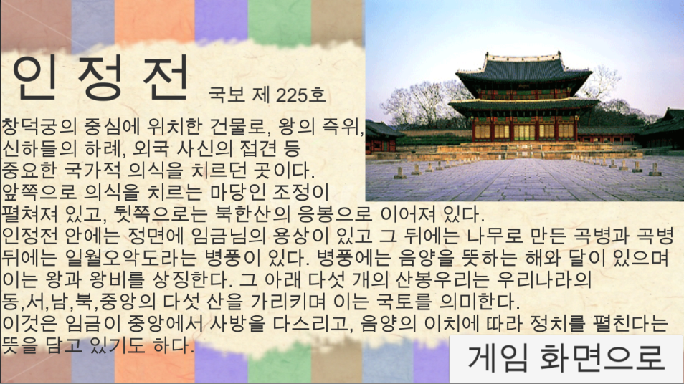
Progress status
Cultural Festival Experience Games
02
Introducing Cultural Properties and Quiz
Introduction of Cultural Heritage
Introduction to the main cultural assets of each stage
Quiz
relating to cultural assets and historical quizzes
Notes:
http://minheeblog.tistory.com/category/PPT

Slide 7
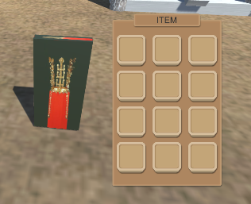
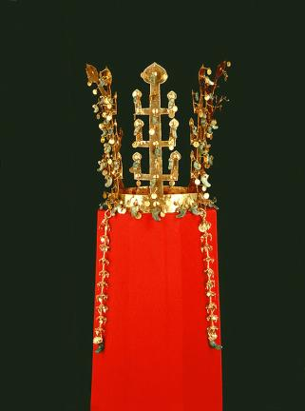
Progress status
Cultural Festival Experience Games
02
item
Gather items from all over the stage and introduce them.
End stage when all items are gathered
Notes:
http://minheeblog.tistory.com/category/PPT

Slide 8
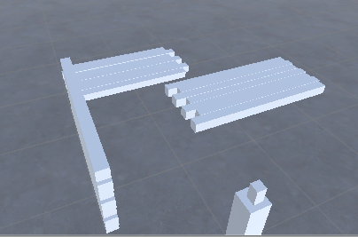
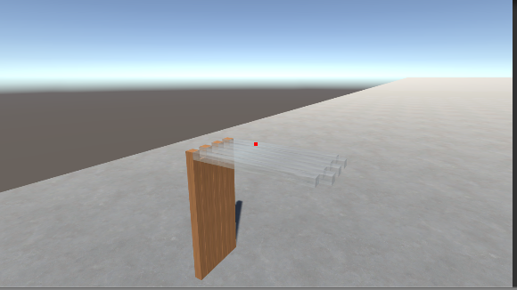
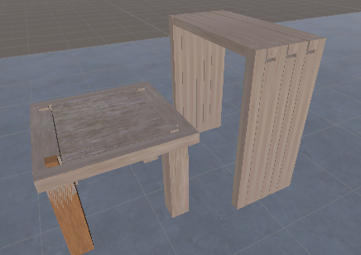
Progress status
Cultural Festival Experience Games
02
Cultural Heritage Experience
somokjang
somokjang is our country's traditional method of woodworking, making grooves in trees and furniture that fits the groove without using nails.
Notes:
http://minheeblog.tistory.com/category/PPT

Slide 9
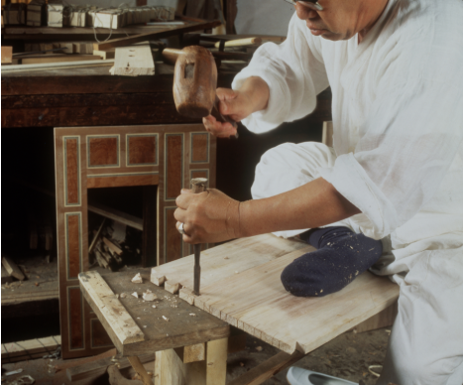
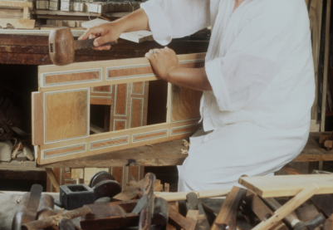
Add-on
Cultural Festival Experience Games
03
Insert Animation
Insert Groove Animation Insert Hammering Animation
VR Interlink
Notes:
http://minheeblog.tistory.com/category/PPT

Slide 10
Roles and schedules
Cultural Festival Experience Games
04
Roles and schedules
choi : Programming
hong : Stage production and data investigation
Details | Period of execution(Month) (Plan : ⇨) |  |  |  |  |  |  |  |  |  |  |  |  |  |  |  | Etc
 | 05 |  |  |  | 06
 | 1 | 2 | 3 | 4 | 1 | 2 | 3 | 4
Insert Animation
VR Interlink
Test and Complement
final presentation
Notes:
http://minheeblog.tistory.com/category/PPT

Slide 11
Cultural Festival Experience Games
Q & A
Notes:
http://minheeblog.tistory.com/category/PPT

Slide 12
Cultural Festival Experience Games
THANK
YOU
Notes:
http://minheeblog.tistory.com/category/PPT

